Slide 1
Design principle

Slide 2
What is Design Principles?
Design principles are said to be a set of guidelines. These guidelines help design complex systems and help developers to have abstract knowledge about solving complex designs.
The design principles are associated to Robert Martin who gathered them in "Agile Software Development: Principles, Patterns, and Practices".
The SOLID (SRP, OCP, LSP, ISP, DIP) principles are one of the most popular sets of design principles.

Slide 3
Solid Principles
S.O.L.I.D - is an acronym based on name of the design principles in the collection:
Single Responsibility Principle (SRP)
Open Close Principle (Open Close Principle)
Liskov's Substitution Principle (LSP)
Interface Segregation Principle (ISP)
Dependency Inversion Principle (DIP)

Slide 4
Other Principles
DRY Principles
KISS Principle
Composition Over Inheritance Principle

Slide 5
Single Responsibility Principle (SRP)
This principle states that each class is responsible for a single purpose. There should be a single reason to change or alter the class. Example, Vehicle class is managing Car and Truck but CarClass and TruckClass is responsible for car and truck instances respectively.

Slide 6
Open/ Closed Principle (OCP)
This principle states that software entities, including classes, modules or methods, should be open for extension and closed for modification. New functionality is added by extending the classes or entities; developed code is not modified, only bugs are fixed.

Slide 7
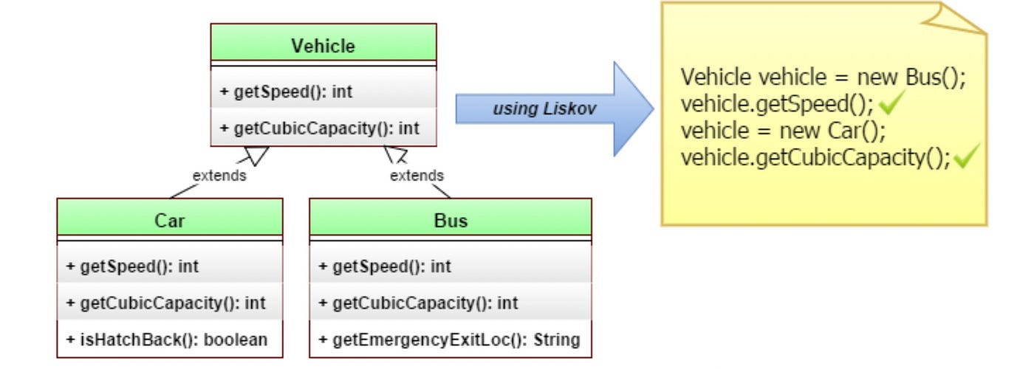
Liskov Substitution Principle (LSP)
This principle states that if there is a pointer that points to base class, it should be able to access the object of derived class.

Slide 8
Interface Segregation Principle (ISP)
This principle states that clients should not be forced to depend upon the interfaces they will not use. This leads to have multiple independent parts rather than having same interface with different functionalities.

Slide 9
Dependency Inversion Principle (DIP)
DIP states that high level modules should be independent from low level modules. Abstractions should not depend upon details. Details should depend upon abstractions. This leads to the development of loosely coupled classes.

Slide 10
Don't Repeat Yourself (DRY)
This principle states that each small pieces of knowledge (code) may only occur exactly once in the entire system. This helps us to write scalable, maintainable and reusable code.

Slide 11
Keep it Simple, Stupid! (KISS)
This principle states that try to keep each small piece of software simple and unnecessary complexity should be avoided. This helps us to write easy maintainable code.

Slide 12
Design Pattern

Slide 13
What is design pattern?
Design Patterns are a reusable solution to typical software design issues that arise frequently in real-world application development.
Patterns are employed by developers to tackle challenges in their individual designs.
Understanding design patterns is more important than memorizing their classes, methods, and attributes.
Induvial needs and difficulties influence pattern selection and usage among numerous design patterns.
There are several design patterns categorized into three main types: creational, structural, and behavioral.

Slide 14
Types of Design Pattern
Creational patterns - These patterns provide freedom of choice between creating objects by hiding the logic. The objects constructed are decoupled from the implemented system. Some of the examples of creational patterns are - Factory design pattern, Builder design, Prototype design, Singleton design, Abstract Factory design.
Structural patterns - These patterns help in defining how the structures of classes and objects should be like for defining the composition between classes, interfaces and objects. Some of the examples of structural patterns are - Adaptor design, Facade design, Decorator design, proxy design etc.
Behavioural patterns - These patterns help to define how the objects should communicate and interact with one another. Some of the examples of behavioral patterns are - Command pattern, Iterator pattern, Observer pattern, Strategy pattern, etc.

Slide 15
Singleton Pattern
Ensures a class has only one instance and provides a global point to access it.
Useful when you want to control access to a resource, like a configuration manager.

Slide 16
Factory Method Pattern
A factory method is a creational design pattern that provides an interface for creating objects in a superclass while allowing subclasses to choose the type of objects created.

Slide 17
Abstract Factory Pattern
Provides an interface for creating families of related or dependent objects without specifying their concrete classes.
Useful when a system should be independent of how its objects are created, composed, and represented.

Slide 18
Builder Pattern
Builder is a design pattern that allows you to build complicated objects in stages.
The pattern enables you to create many types and representations of an object while using the same creation code.

Slide 19
Prototype Pattern
Prototype is a design pattern that allows you to imitate existing objects without making your code reliant on their classes.
The prototype pattern provides a basic interface for working with all objects that permit cloning to the client code.

Slide 20
Structural Design Patterns

Slide 21
Adapter Pattern
Allows the interface of an existing class to be used as another interface.
Useful when you want to use an existing class with a different interface.

Slide 22
Bridge Pattern
Bridge is a structural design pattern that allows you to split a large class or a collection of related classes into two independent hierarchies.
Useful when you want to avoid a permanent binding between an abstraction and its implementation.

Slide 23
Composite Pattern:
Composite is a structural design pattern that enables you to organize parts into tree structures and manipulate them independently of one another.
The composite pattern provides two basic element kinds with a shared interface.
Simple Leaves
Complex containers

Slide 24
Decorator Pattern
Decorator is a structural design pattern that allows you to add additional behaviors to objects by wrapping them in special wrapper objects.
Useful when you want to extend the functionality of objects in a flexible and reusable way.

Slide 25
Facade Pattern
Façade is a structural design pattern that simplifies complex library, framework or class interfaces.
When you require a simple but limited interface to a complicated subsystem, use the façade pattern.

Slide 26
Proxy Pattern
Proxy is a structural design technique that enables you substitute an item.
A proxy controls access to the source object, allowing you to do actions before on after the request.

Slide 27
Behavioral Design Patterns

Slide 28
Observer Pattern
Defines a one-to-many dependency between objects so that when one object changes state, all its dependents are notified and updated automatically.
Useful when an object should notify its dependents about state changes.

Slide 29
Strategy Pattern:
Strategy is a behavioral design pattern that allows you to construct a family of algorithms, classify them, and make their objects interchangeable.
When you have a bunch of similar classes that just differ in how they perform some behavior use the strategy.

Slide 30
Command Pattern
Command is a behavioral design pattern that turns a request into a standalone objects.
This transformation supports unachievable operations and passing requests as method arguments.

Slide 31
State Pattern
State is a behavioral design pattern that allows an entity to change its behavior in response to changes in its internal state.
It appears that the object’s class has changed.

Slide 32
Chain of Responsibility Pattern
A behavioral design pattern called Chain of Responsibility allows you to pass requests along a chain of handlers.
When a request it received, each handler determines whether to process it or send it on to the next handler in the chain.

Slide 33
Iterator Pattern:
Iterator is a behavioral design pattern that allows you to traverse components of a collection without revealing the representation below (list, stack, tree, etc).
Iterator can be used to traverse composite trees.

Slide 34
Visitor Pattern
Represents an operation to be performed on the elements of an object structure.
Useful when you want to define a new operation without changing the classes of the elements on which it operates.

Slide 35
Memento Pattern
Memento is a behavioral design pattern that saves and restores an object’s prior state without revealing its implementation.
When you need to take pictures of an object’s state in order to restore it to a previous state, use the memento pattern.

Slide 36
These design patterns are proven solutions to common software design problems. Understanding and applying them can lead to more flexible, maintainable, and scalable software systems. When using design patterns, keep in mind that they are tools, not rules, and their application should be based on the specific requirements of your project.

